Slide 1
Android Permission Model
2018/06

Slide 2
Contents
Basic
Android Permission
Custom ROM
Problem

Slide 3

Basic : sandbox
User ID - Each application has a unique User ID
Group ID - Each User ID has a unique Group ID, and this Group ID may belong to members of other GroupID
Groups - Each Group ID belongs to certain groups such as inet for internet, sdcard_rw for External storage read-write, etc.

Slide 4
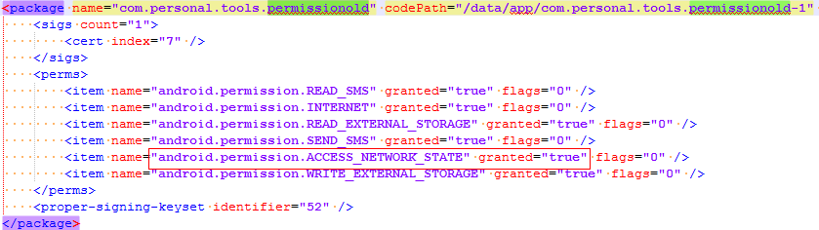
Android Permission
Android M Less
Install Permission
/data/system/packages.xml

Slide 5
Android Permission
Android M 6.0
Permission Category
Normal , Dangerous
frameworks/base/core/res/AndroidManifest.xml
Frameworks/base/data/etc/platform.xml
System/core/include/private/android_filesystem_config.h

Slide 6
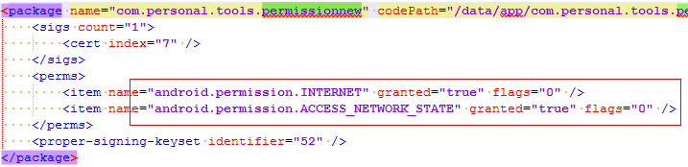
Android Permission
Install Permission
/data/system/packages.xml

Slide 7
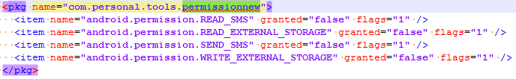
Android Permission
Runtime Permission
/data/system/users/0/runtime-permissions.xml

Slide 8
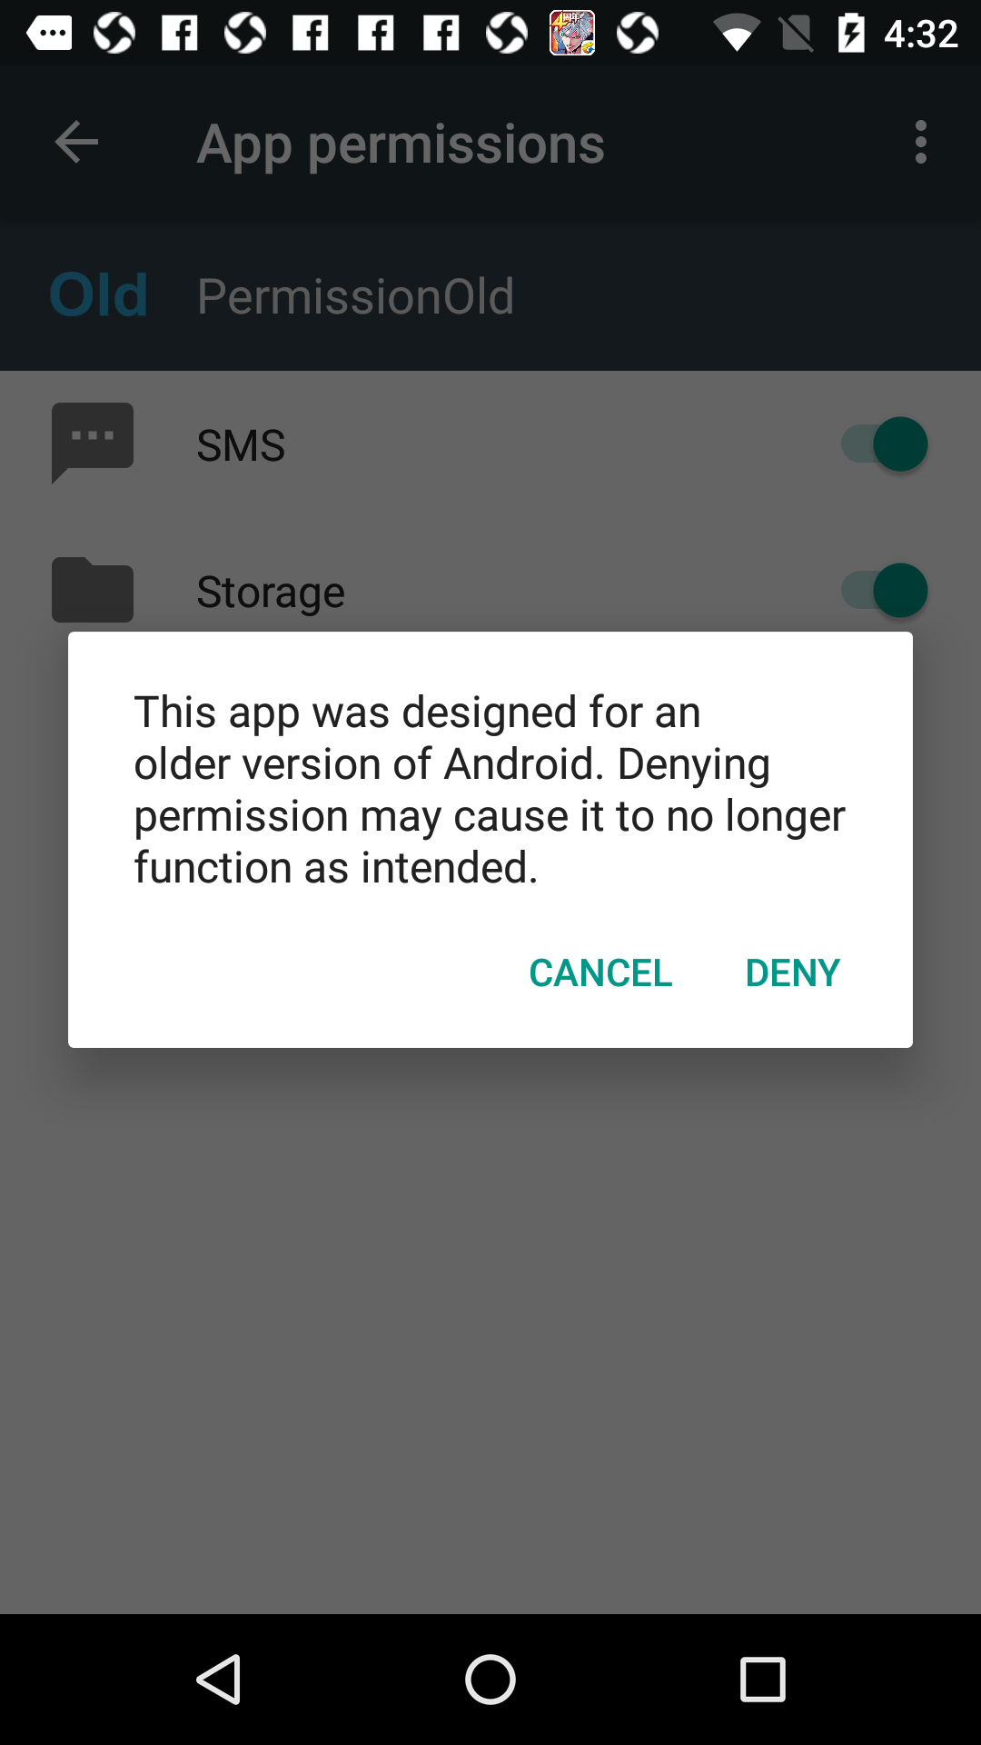
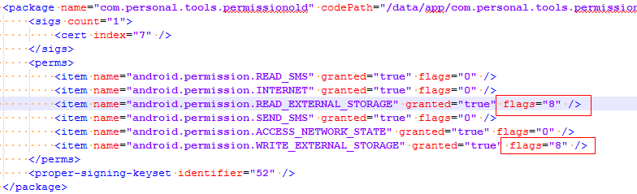
Android Permission
Compatible
App target sdk version < 23 run on Android 6.0
FLAG_PERMISSION_REVOKE_ON_UPGRADE = 1 << 3

Slide 9
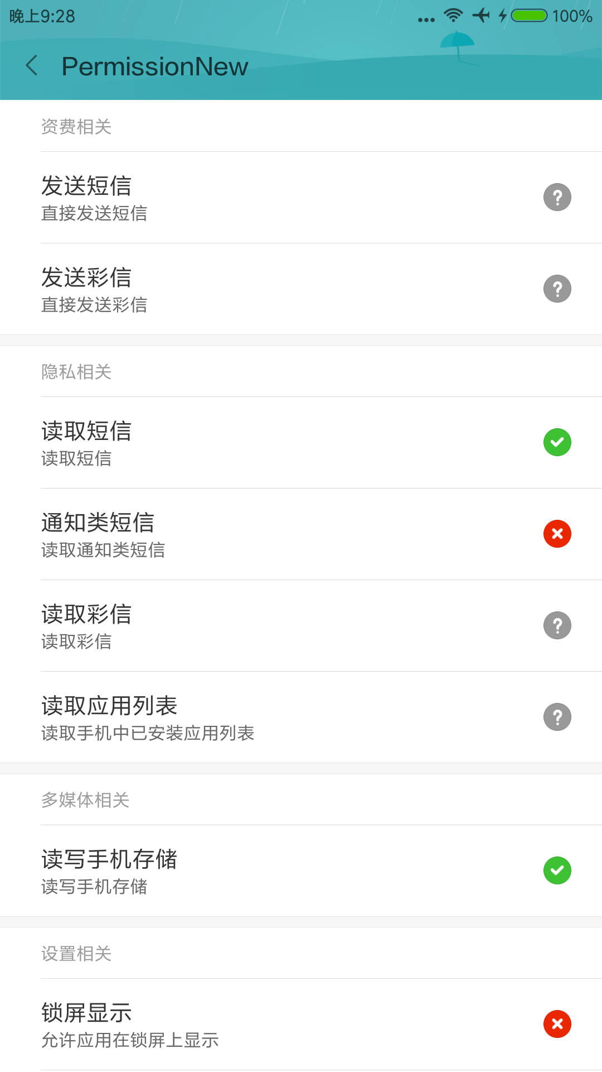
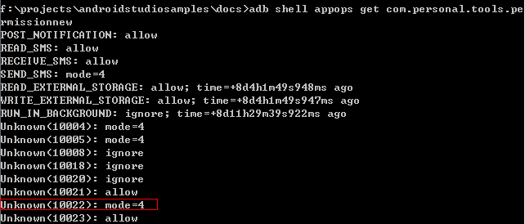
Custom ROM
Security Center

Slide 10
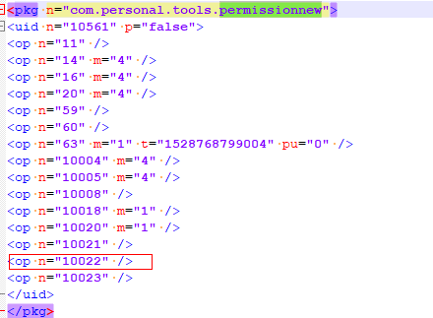
Custom ROM
/data/system/appops.xml

Slide 11
Problem
Installed Packages List Permission
Installed Packages
File : /data/system/packages.xml
Memory : PackageManagerService system_service

Slide 12
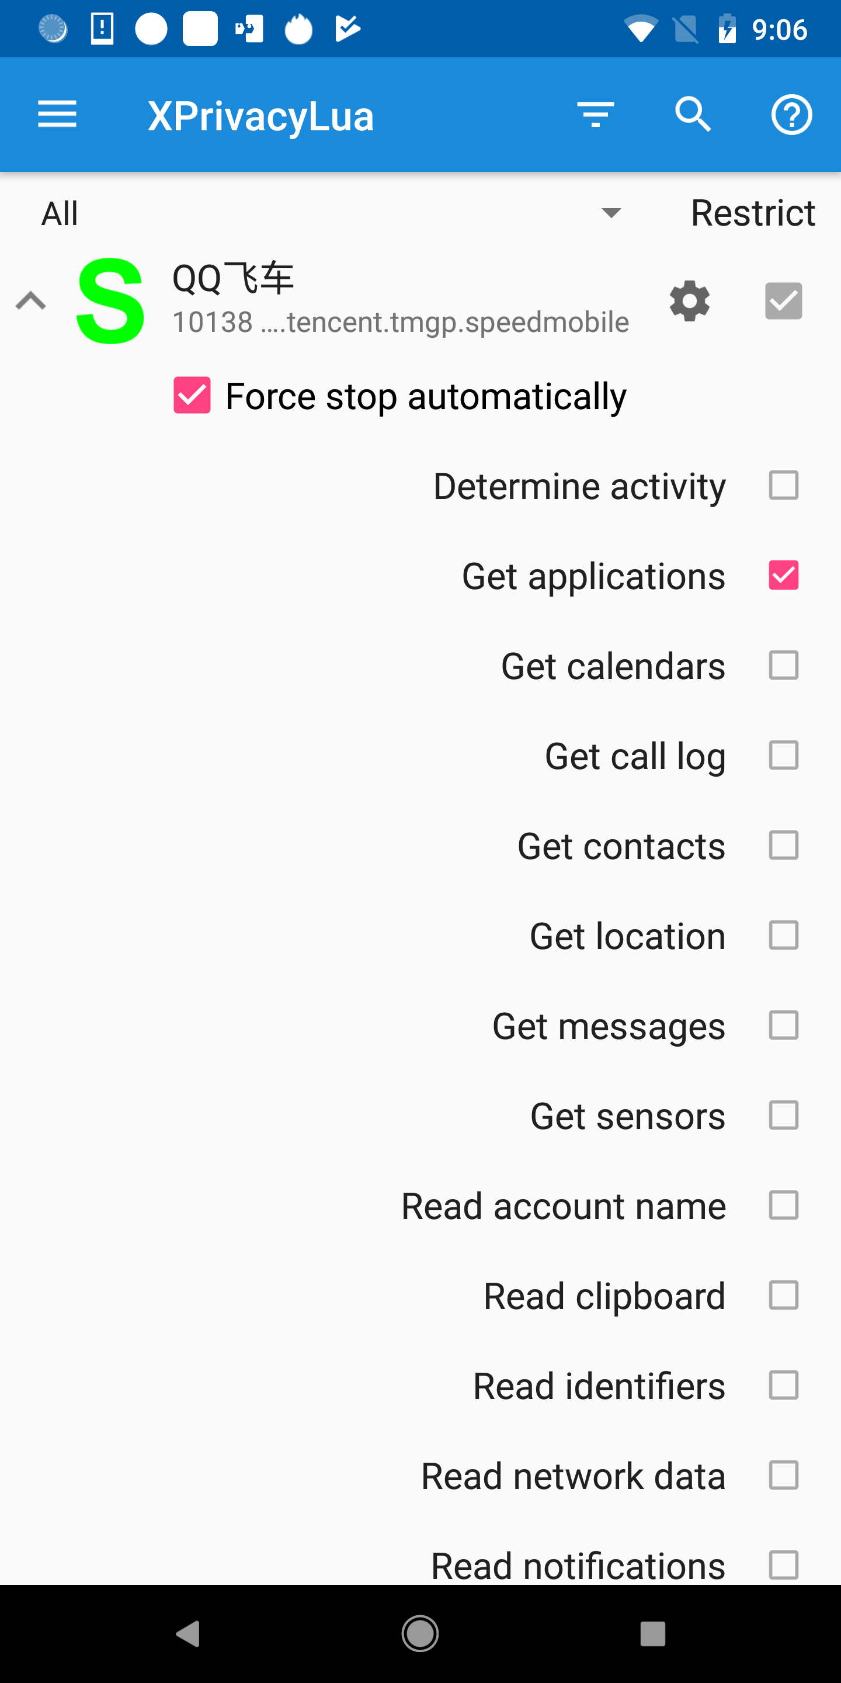
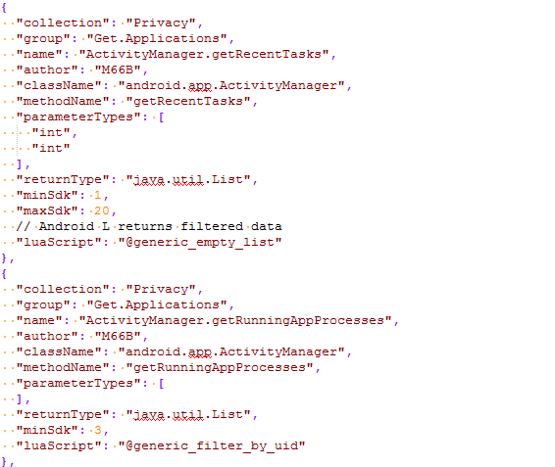
Problem
Xposed

Slide 13
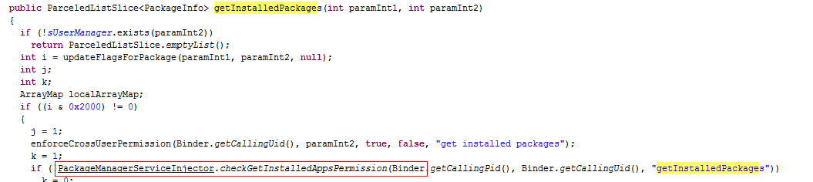
Problem
Custom ROM : MI 7.0

Slide 14
THANKS

